Slide 1
CAPSTONE PROJECT - 6
FRAUD ANALYSIS USING ML ALGORITHMS
By Subasish Mondal
Batch: AIDL-II
IIT Ropar & TSW

Slide 2
Problem Statement
In this capstone project, you are going to analyze customer’s purchase data set and build a machine learning algorithm to detect fraud purchases. And also, you are going to perform customer segmentation.

Slide 3
Part - 1
Fraud Detection using ML algorithms

Slide 4
Approach
Understanding the data.
Pre-Profiling the data.
Performing Exploratory Data Analysis
Data visualization using bivariate and multivariate charts
Feature Extraction
Encoding categorical columns
And finally, proposing the best suited model based on the F1_score & the Accuracy of the model
Applying Machine Learning Classification Algorithms & training the same
Hyper-tuning of the ML models & applying Ensemble technique

Slide 5
Trend Analysis
&
Inferences
max growth

Slide 6
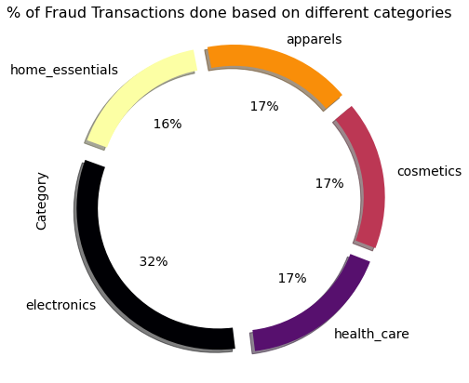
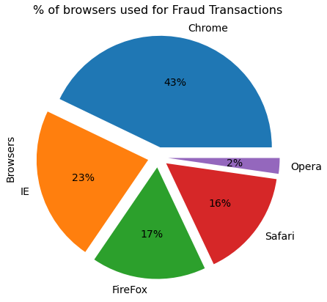
Percentage of Fraud Transactions based on different categories
Percentage of Fraud Transactions based on different browsers

Slide 7
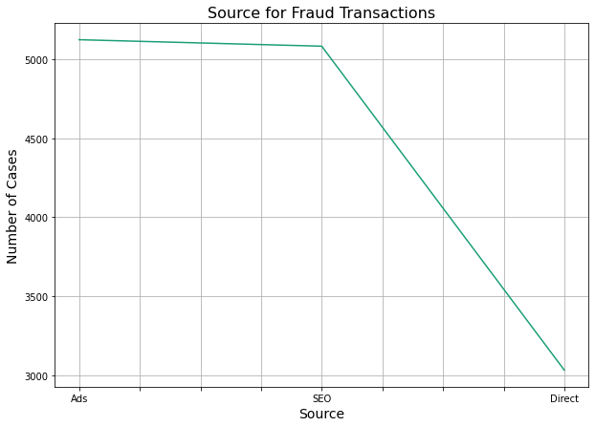
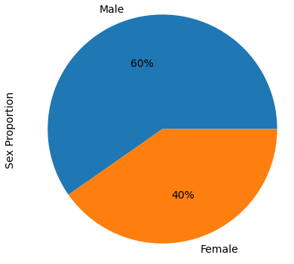
Sources of Fraud Transactions
Sex distribution based on Fraud transactions

Slide 8
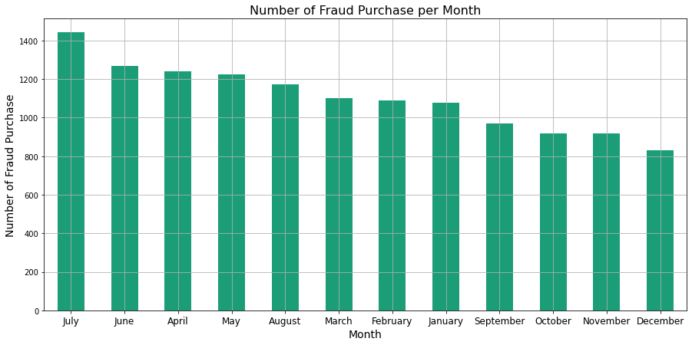
Most of the fraud purchases have occurred in the month of July

Slide 9
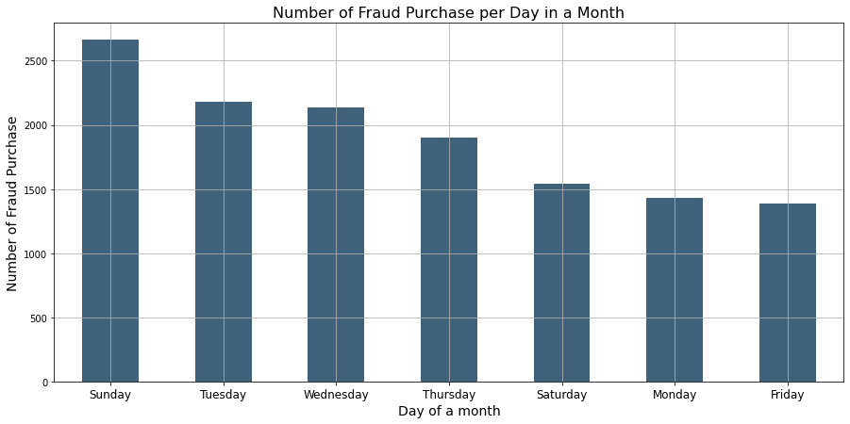
Most of the fraud purchases have occurred on Sunday’s in month

Slide 10
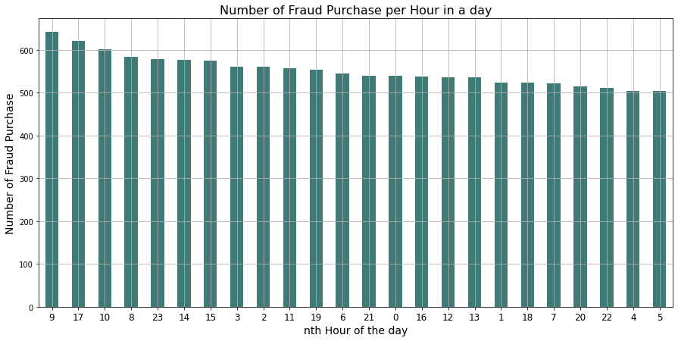
Most of the fraud purchases have occurred in the 9th hour in a day

Slide 11
Model Validation & Selection
Logistic Regression - F1_ score : 0.48
Decision Tree - F1_score: 0.76
Random Forest - F1_score: 0.76
K- Nearest Neighbor - F1_score: 0.70
SVM - F1_score: 0.00
Naive Bayes - F1_score: 0.06
XGBoost - F1_score: 0.98

Slide 12
Business Impact
The model built using XGBoost algorithm, helps in improving the efficiency in detecting fraud transactions by 98% and thus helps to prevent such transaction amounting up to approximately, 2 million dollars

Slide 13
Part - 2
Customer Segmentation

Slide 14
Approach
Understanding the data.
Applying KNN algorithm
Finding the ideal number of clusters using Elbow method
Segmenting the customer as per the label
Re-iterating the KNN model
Labelling the data

Slide 15
Customer segmentation based on clustering
max growth

Slide 16
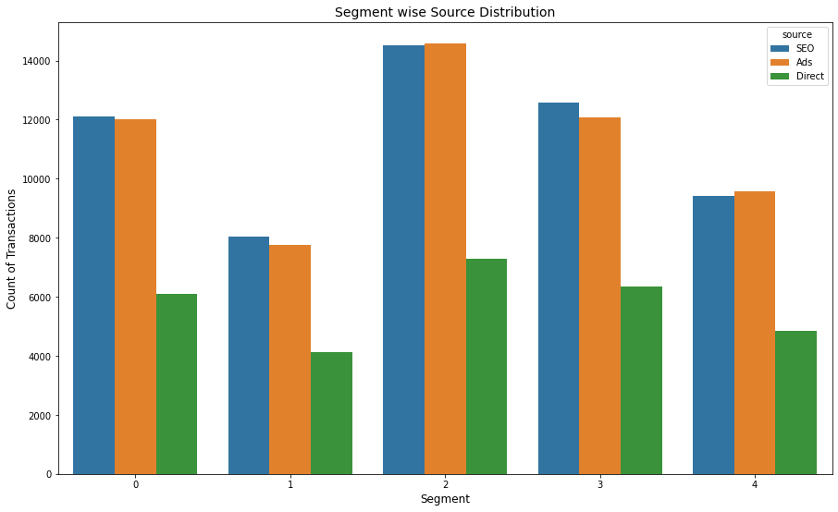
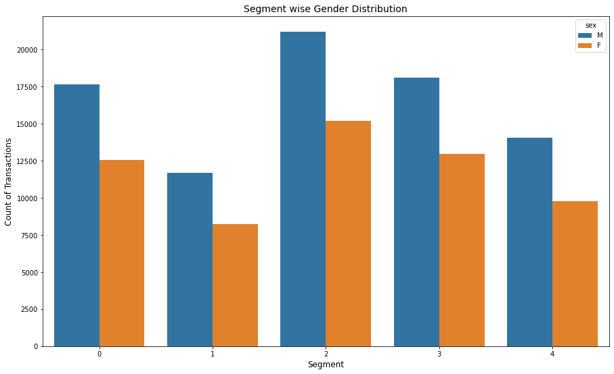
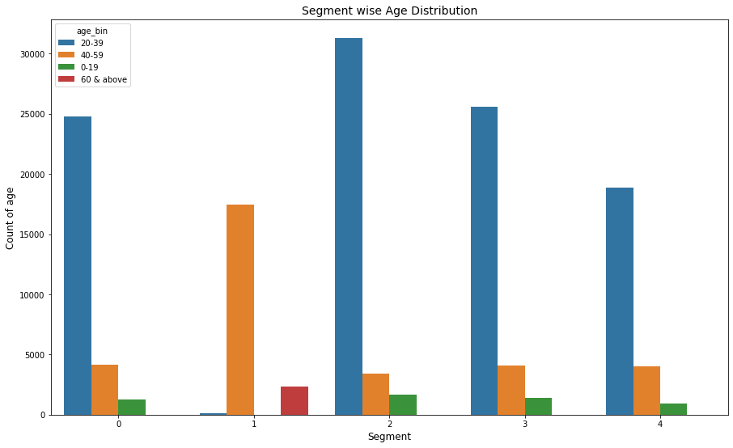
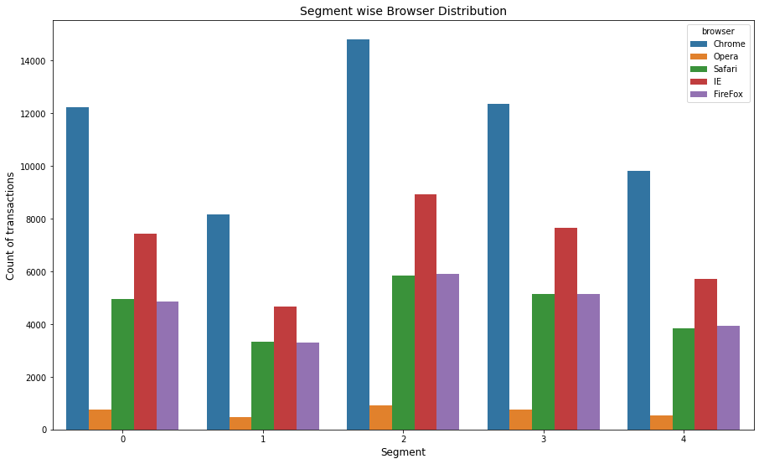

Slide 17
Thank You

